Slide 1
Introduction to Data Analytics Sprint 1 Project Review
Kiplangat Stanley
Turing College

Slide 2
1. ASK. The Problem Statement
A popular restaurant in New York wants to expand its business portfolio into other regions. It needs to find out which region East or West is most favourable for business and which food product category gets the highest sales.

Slide 3
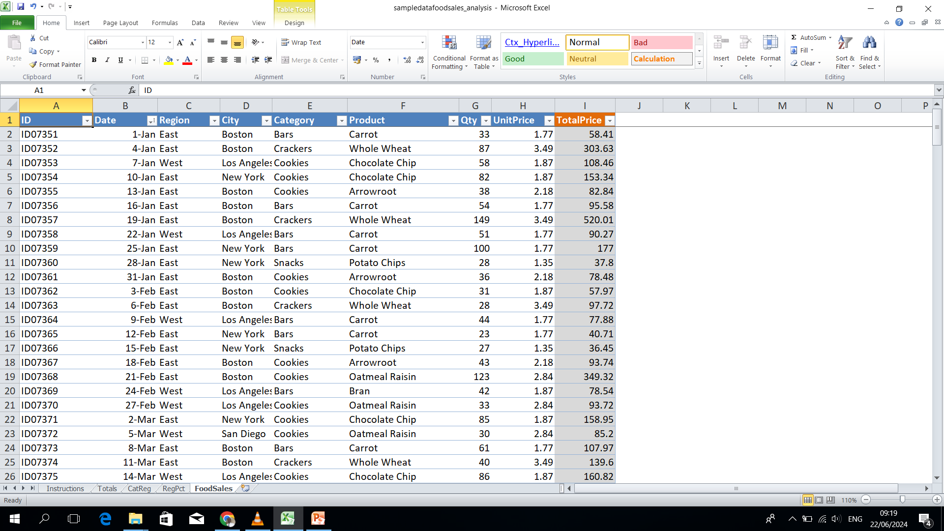
2. PREPARE. I sourced an excel sheet online with various food product sales in different cities
Sample Data in Excel showing the sales of different food products

Slide 4
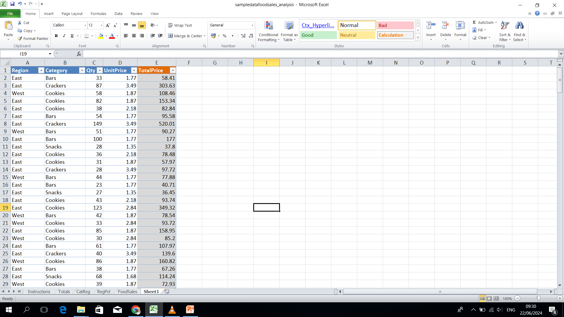
3. PROCESS.
The unwanted fields such as ID, Date, City and Product are removed. Data cleaning is also carried out to check for empty fields and null fields.

Slide 5
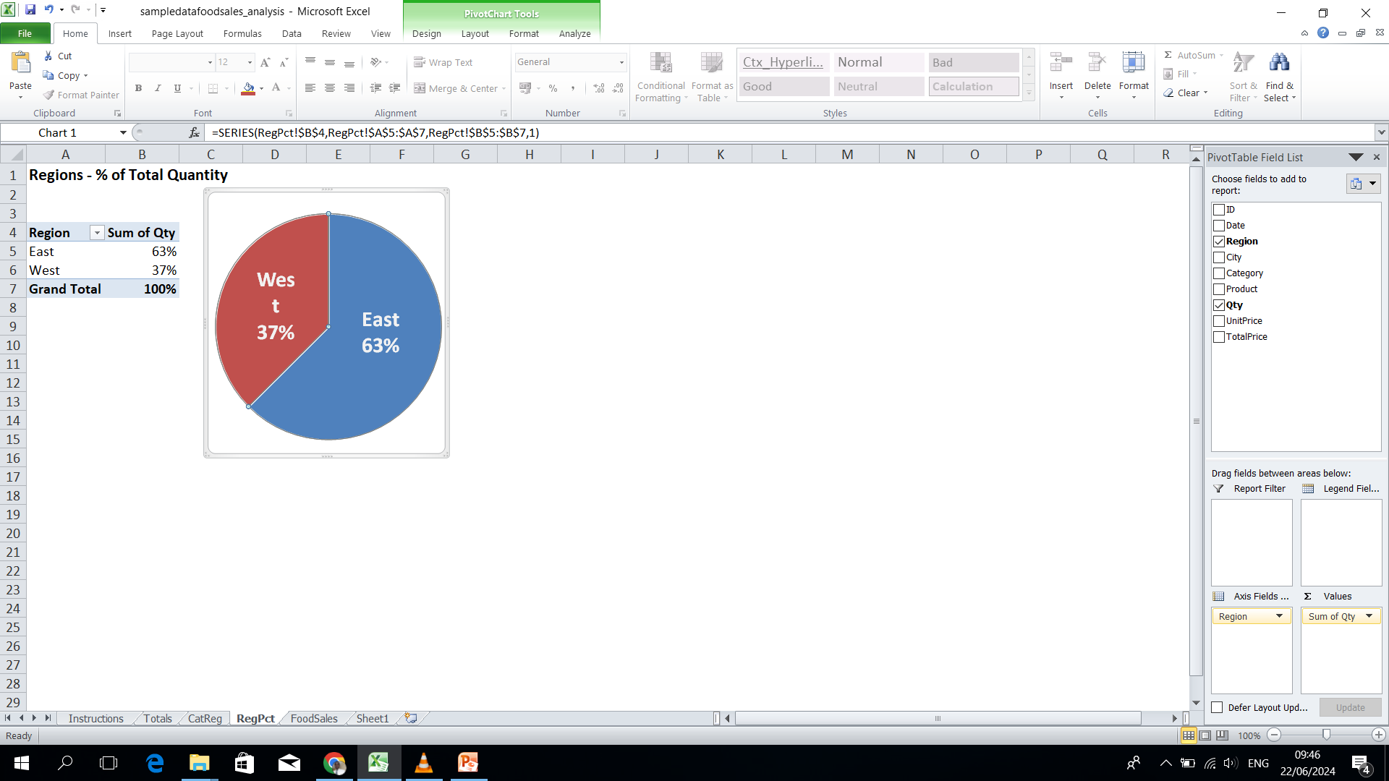
4. ANALYZE. Sales Per region using a pie chart
The East region has the biggest share of sales at 63%

Slide 6
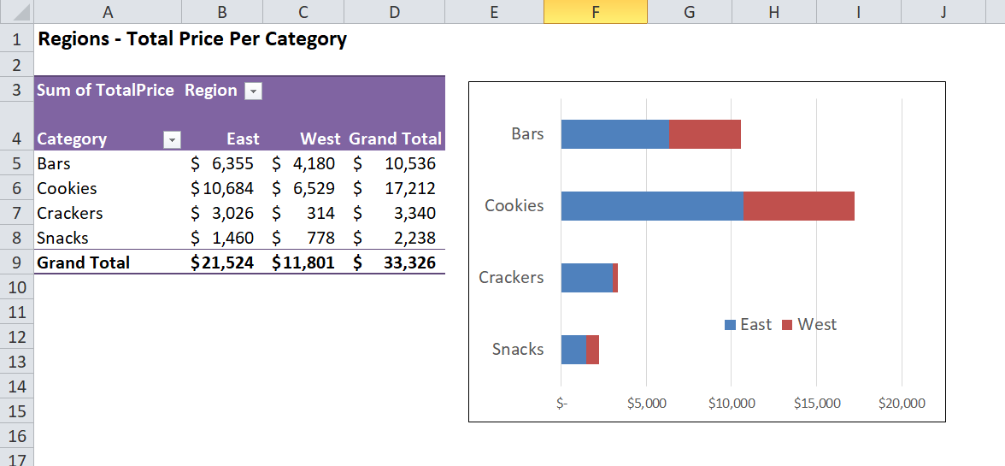
Regional Sales per Category
Cookies category products are the highest selling in both regions followed by bars

Slide 7
CONCLUSION AND FINDINGS
The best region to invest in food sales is the East region which holds two thirds of the total sales.
The best selling food product categories in order are:
Cookies
bars
Crackers
Snacks

